Slide 1
Swish Solar Take home assessment, Interview stage 2
Arvin Asgharian Rezaee
Firstly, thanks for the opportunity

Slide 2
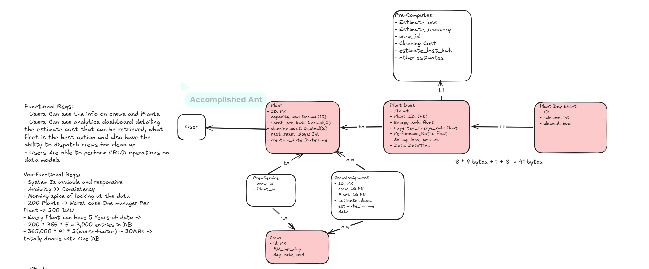
1: What I Built, And the Journey
First step was modelling and system design.
Spent about 1 to 1:15 hours deriving requirements and designs
Notes:
Had to think How to represent the system in a relational-database
What relation-ships made sense to add (example crew servicing only select plants)
How to handle minimal Auth: (admin, solar123)
Decided to at least have a general view of most items for all users
Decided to build for availability not consistency. Reject showing data if you are not sure
Played around with some numbers, settled with single postgres for both Datbase and Database caching

Slide 3
Major Decisions
Crews can only service certain plants based on their region
Crews' cleaning time and cost of cleaning are not static and derived for each crew based on their rate and speed
Pre-compute data to avoid 8AM spikes. Use cron-jobs and store the data inside of the database. Edge cases: A) Updates have to invalidate the report and recompute B) failed jobs mean no report in the morning -> send compute request
Simple background workers with no broker. Uses the DB. Overhead polling is bad but at this rate it's not our main concern
Frontend is one giant dashboard with design based on swishsolar.com. See entities and make simple decisions

Slide 4
What I avoided
Redis caching -> Compute time is the bottleneck, not the disk VS memory round trip
Statistical modeling for loss estimation -> Lost time I can work on enhancing other features
Dedicated roles and permissions -> Goal is to showcase data modelling, not creating an Auth service
No automated day entry creation or simulated signal from 3rd party MockAPI. Flexible structure can be expanded for this, but I assumed this to be out of scope

Slide 5
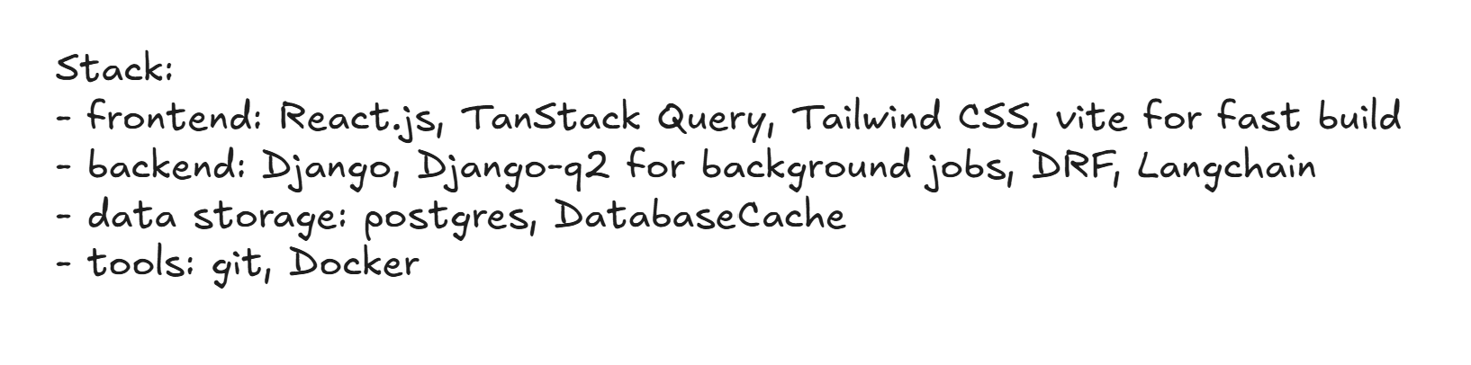
DEMO TIME

Slide 6
2: What I am Unsure
Lack of understanding of solar energy -> Is how I modeled the energy estimation and the cost calculation correct?
Burst of users at 8AM -> Which 8AM at which zone?
Is zonality something we have to take into consideration? Can one DB/API serve all of our users?
How long can the system handle no-dedicated broker for background tasks?

Slide 7
3: What Breaks First
Auth system: Every user can see everything/edit everything. Any authenticated user has total access
Pre-compute system is a bit unreliable. A system-wide failure will spike usage in the morning and bring down service. No retry or observability baked in
Database has no backup; meaning an outage/data loss is lethal for it
No unit tests -> collaboration will be a nightmare

Slide 8
4: What I would Build next
Queue system + Producer/Consumer pattern for precomputing tasks to avoid silent failures.
Better Auth system, with row-level access and defined permissions
Moving the database to a cloud provider for both reliability assurance and multi-zone availability
Distributed caching with Redis
Server-Sent Events (SSE) instead of needing to refresh for updates to arrive for analytics

Slide 9
5: Improvements On the Brief
How high-level/low-level should decision log be?
Any dealbreaker features needed?

